Slide 1



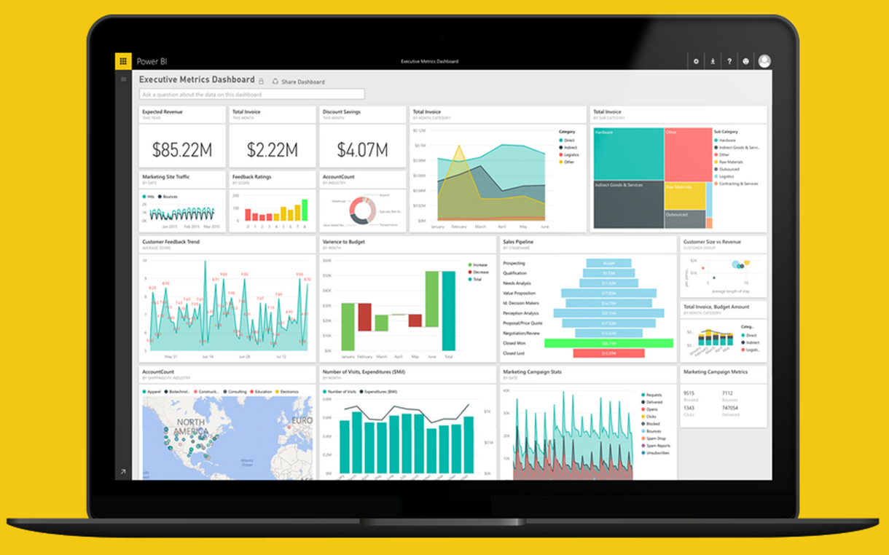
Project Professional Workshop Program
Module 5 – Fantastic Functions and Where to Find Them

Slide 2

COURSE OBJECTIVES
By the end of this course, you will be able to use DAX to create calculations in a Power BI Desktop data model. Specifically you will be able to:
Understand basic concepts of Data Modeling
Understand the consequences of data model design decisions
Understand concepts of calculated columns and measures
Gain familiarity with standard DAX patterns & CALCULATE
Understand evaluation contexts and their impact on calculations
Gain ability to parse data modeling formulas

Slide 3
Recap & DAX Concepts Module 4a

Slide 4
Module 4a - DAX Evaluation Contexts
Any DAX expression is evaluated inside a certain context
The context is the environment under which the formula is evaluated
“The surrounding area of the cell where DAX evaluated the formula”
2 Kinds
Row Context – the context that always contain a single row and DAX defines during the creation of the formula
Filter Context – based on the context defined by it’s current filters & environment
Notes:
Context
Oh boy…. This is the tough one
This does take some time to understand, but basically every DAX expression is evaluated inside a certain “environment”
This depends if it is a column or a measure, in a table or on it’s own
Row Context
More for Calculated Columns – iterates on every row of a table/column
Cannot look at other rows! Just the one it is on
Filter Context
Based on the current area or situation a expression is in
Can ignore row context, especially aggregations.
Not based on every row
For example, a measure of total sales when adding different columns and rows

Slide 5
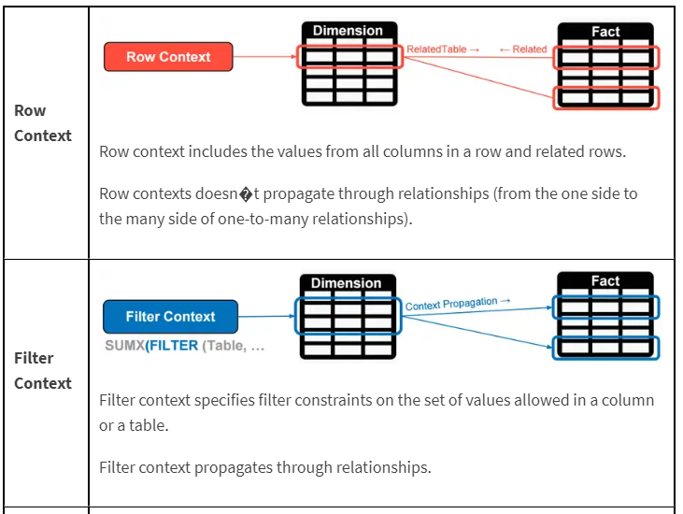
Module 4a – DAX Evaluation Contexts
Filter Context
Comes initially from the visual coordinates.
Can be modified by the functions like CALCULATE().
Follows the one to many relationships automatically.
Bidirectional filtering can be forced.
Row Context
Exists in calculated columns.
Exists in special DAX functions like SUMX and FILTER.
Does not follow relationship.
A row Context does not create a filter context.

Slide 6
DAX Function Types
Module 4a – DAX Evaluation Contexts
Scalar Functions
Table Functions
Scalar functions return a Single value as an output
Ex. SUM(Sale[Sales Amount])
Table functions return a Table as an output
Ex. ALL(GeographyDim)
There are other ways to classify functions – By kind of operation they perform etc.
Notes:
Scalar is a fancy word for using a single coordinate in the evaluation
What if you want bring in a Table or List of values and apply your calculation to them?

Slide 7
PATH to DAX Expertise
Module 4b – CALCULATE & Variables
Evaluation Contexts
CALCULATE
Calculated Columns and Measures
Notes:
Evaluation Context – Single biggest reason that people give up on DAX
Want to Simplify the Evaluation Context

Slide 8
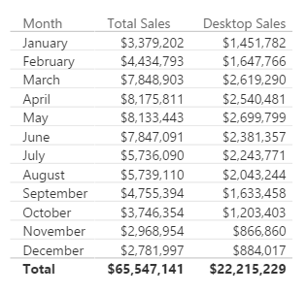
Here is how you do it with CALCULATE
Module 4b – CALCULATE & Variables
[Desktop Sales] = CALCULATE([Total Sales], CampaignDim[Device] = "Desktop")
Use CALCULATE function to create a Measure which filters down to Desktop Sales
Notes:
Note that even if you apply a “Device” Slicer to this page, the measure [Desktop Sales] will always show Desktop

Slide 9
Module 4b – CALCULATE & Variables
[Desktop Sales] = CALCULATE([Total Sales], CampaignDim[Device] = "Desktop")
[Tablet Sales] = CALCULATE([Total Sales], CampaignDim[Device] = “Tablet")
[Mobile Sales] = CALCULATE([Total Sales], CampaignDim[Device] = “Mobile")
Add Filter
Ignore Filter
Update Filter
Convert Row Context to Filter Context
Notes:
Demo: Table from “Calculate-Add” report
Note the effect that the Year Slicer has on the table (All items change)
When the Device Slicer is selected, only “Total Sales” changes.
Filter Context : Jan + 2015
Jan + 2015 + Desktop
Jan + 2015 + Tablet

Slide 10
Module 4b – CALCULATE & Variables
[Total Sales All Geo] = CALCULATE([Total Sales], ALL(GeographyDim))
[Total Sales All States] = CALCULATE([Total Sales], ALL(GeographyDim[State]))
[Total Sales All Selected States] = CALCULATE([Total Sales], ALLSELECTED(GeographyDim[State]))
Add Filter
Ignore Filter
Update Filter
Convert Row Context to Filter Context
Notes:
DEMO “Calculate- Ignore” Tab:
The table visualization, with each slide, expose the related column
Expose measure called [Total Sales All Geo] – Ignore filter on ANY column from the GeographyDim table, but allows filters from Year
Discuss that this measure can be used to calculate a % of Total measure
DEMO “Calculate- Ignore” Tab:
The table visualization, with each slide, expose the related column
Expose measure called [Total Sales All State] – Ignore filter on the STATE column from the GeographyDim table, but allows filters from Year
Slice on City (Aberdeen is good)
DEMO “Calculate- Ignore” Tab:
The table visualization, with each slide, expose the related column
Expose measure called [Total Sales All Selected State] – Ignore filter on the STATE column from the GeographyDim table, but allows filters from Year
Slice on City (Aberdeen is good), then select multiple State, see that the measure now only displays the total for selected states.

Slide 11
Module 4b – CALCULATE & Variables
[2014 Sales] = CALCULATE([Total Sales], DateDim[Year] = 2014)
Add Filter
Ignore Filter
Update Filter
Convert Row Context to Filter Context
Notes:
DEMO “Calculate- Update” Tab:
The measure called [2014 Sales] – Ignores filter on the Year Slicer.
This is different than just using FILTER because Calcuate updates the filter context, FILTER creates a filter Context

Slide 12
Module 05: Fantastic Functions & Where to Find Them

Slide 13
Module 05 – Popular DAX Expressions
Fantastic Functions and Where to Find them
Over 200+ DAX functions, with 10 Categories
New ones added monthly

Slide 14
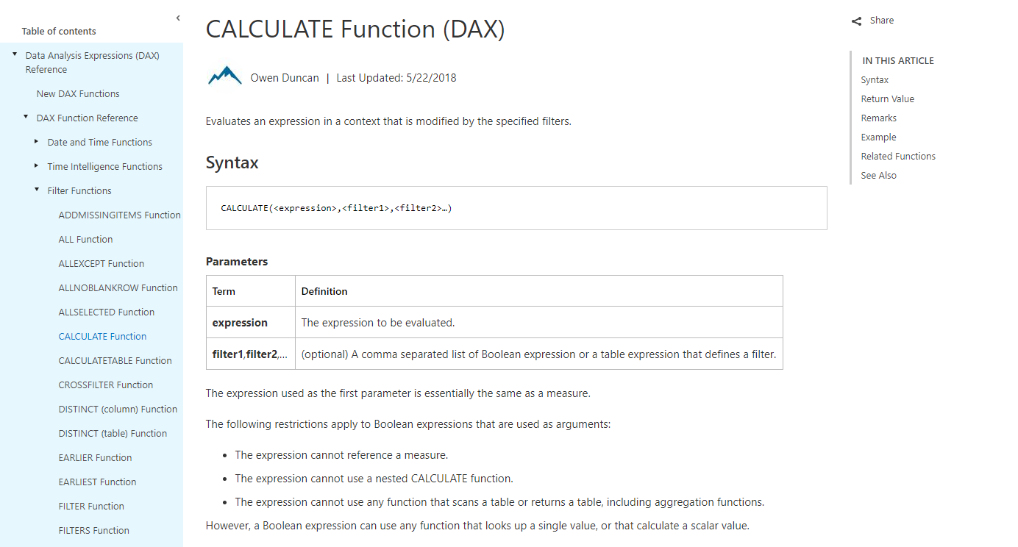

Slide 15
Module 05 – Popular DAX Expressions
MSDN gives every function:
Description
Syntax & Parameters for function
Return Value
Example
Remarks & Related

Slide 16
Module 05 – Popular DAX Expressions
DAX Function Main Categories
Date and Time Functions
Time Intelligence Functions
Filter Functions
Information Functions
Logical Functions
Math & Trig Functions
Statistical Functions
Text Functions

Slide 17
Module 05a: The Basics DAX

Slide 18
Module 05a – The Basics
Why you need to Know the Basics
These create your foundational measures
Build off the Basics
More reliable, formatting options
Begin to learn how DAX works
Notes:
The Basic functions can only be known as the “Commons”, or the base functions. These are the ones that do your simple calculations, like SUM or AVERAGE or DIVIDE.
You use these in the more complex functions, and this greatly helps with not redoing the same logic in more complex formulas.
Also ensures reliable data from the start.

Slide 19
Module 05a – The Basics
Every DAX Function has required “ingredients” (Parameters)
Parameters can be an expression, table, column, value, etc.
Important to understand parameters per function
They also all have a specified Return Value
Can be an expression, scalar value, or even a table
Notes:
So let’s start with what make ups a DAX function.
Think of DAX functions like a Recipe. Every DAX recipe has required instructions & ingredients. These ingredients are known as parameters.
The parameters, like ingredients, need certain types of input to work correctly. You would never look at a cake recipe and subsite salt for sugar!
Parameters thus can make up a variety of inputs. Some functions need a table expression, a scalar expression, or a true /false.
Also, like a Cake, once you put the parameters in, every dax function (even ones that are nested) return a certain value.
Parameter Names
Paramter Description
expression Any DAX expression that returns a single scalar value, where the expression is to be evaluated multiple times (for each row/context).
value Any DAX expression that returns a single scalar value where the expression is to be evaluated exactly once before all other operations.
table Any DAX expression that returns a table of data.
tableName The name of an existing table using standard DAX syntax. It cannot be an expression.
columnName The name of an existing column using standard DAX syntax, usually fully qualified. It cannot be an expression.
name A string constant that will be used to provide the name of a new object.
order An enumeration used to determine the sort order.
ties An enumeration used to determine the handling of tie values.
type An enumeration used to determine the data type for PathItem and PathItemReverse.

Slide 20
Module 05a – The Basics
Examples
SUM
Syntax – SUM ( <column> )
Parameters – column, contains the numbers to sum
Return Value – a decimal number
IF
Syntax – IF ( <logical_test> , <value_if_true> , <value_if_false> )
Parameters –
Logical test – any value or expression that is TRUE or FALSE
If true – the value that is return if the test is TRUE
If false – the value that is returned if the test is FALSE
Return Value – any type of value that can be return by an expression
Notes:
Lets take a look at 2 examples. Basic ones from Excel but we see the ingredients are different form Excel.
For SUM, you can see that all it needs a Column. That’s it. But nothing more or less. It returns the total of that column. This is part why you do not reference single cells, and you do not use SUM in a column. Only a Measure.
SUM always takes a column, that’s it. Returns all numbers contained in the Column
IF works based on a row by row basis. Same as Excel, but the value if true for that row.

Slide 21
Module 05a – The Basics
DAX Functions are not all equal.
Some DAX functions are meant solely to be an expression, value, or filter for another Function.
Thus, all DAX Functions are not meant to be used alone.
Nested Functions, or Companion Functions
Notes:
This brings up the important aspect that DAX functions are not all alike. They do not all return or have the same indented purposes.
If a function needs a table expression, you cannot use SUM for example. You need a function that returns a table. Even if it is virtual.
These base functions are used usually alone, but complex functions are not.
Examples of a companion function is DatesYtD, or simply just “filtering” a table

Slide 22
Module 05a – The Basics
Nested Functions Examples
CALCULATE
Syntax – CALCULATE ( <expression> , <filter1> , <filter2>)
Parameters
Expression – what you are evaluating (SUM)
Filter1, filter2… - a list of Boolean expression or a table expression that makes a filter
Return Value – the value that is the result of the expression
CALCULATE ( SUM ( Table[Column] ) , Table[Column] = “Yes” )
CALCULATE ( [Measure] , DATESYTD ( Table[DateColumn] ) )
Notes:
Let’s take a look at a more complex Function that used other functions (nested). CALCULATE is our best example.
CALCULATE needs an expression, pretty much what we want the output to be. What are you aggregating or trying to get?
Then, it needs a list (at least one) of true / false or table expressions that are a filter. These are usually some type of functions or yes or no values.
Finally, it returns the result of the expression using the filters you provided.
Take a look at the first example. The expression is the SUM of a column, and then we are saying that a certain table and the column must be “Yes” for each row. Thus, the filter we are using is a table filter.
The next example is using a Measure already created (base function) as the expression, and then we are using the DATESYTD, which always return an unique table with one column for dates up to the current date. So the Measure is going to be evaluated in the context of that DatesYTD and any filter context in our visuals, or come from the outside.
Examples of a companion function is DatesYtD, or simply just “filtering” a table

Slide 23
Module 05a – The Basics
The Commons - Measures
SUM
DIVIDE
COUNTROWS
DISTINCTCOUNT
MAX
AVERAGE
The Commons - Columns
IF
RELATED
LOOKUPVALUE
ISBLANK
Notes:
So lets take a look at our common functions. We have them broken out based on for Measures (to aggregate) and by Columns (row by row).

Slide 24
Module 05a – The Basics – Commons Measures
SUM
Adds the numbers of a Column together
DIVIDE
Division and returns alternate result if by 0
COUNTROWS
Counts the number of Rows in a table
DISTINCTCOUNT
Counts the number of distinct values in a column
MAX
Returns MAX value from a Column

Slide 25
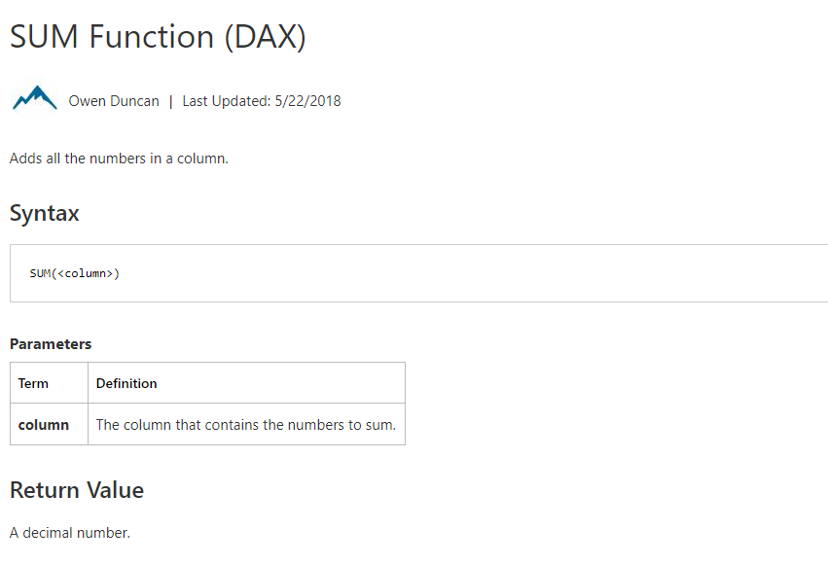
Module 05a – The Basics – Commons Measures
Notes:
You basic SUM. It does everyone you expect it too.

Slide 26
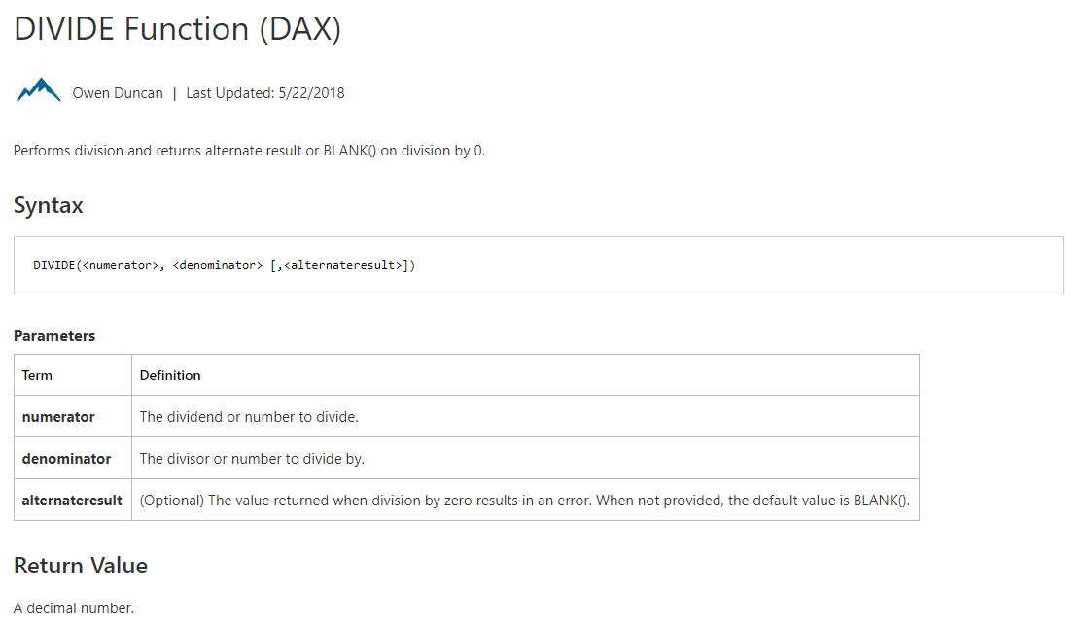
Module 05a – The Basics – Commons Measures
Notes:
Divide.

Slide 27
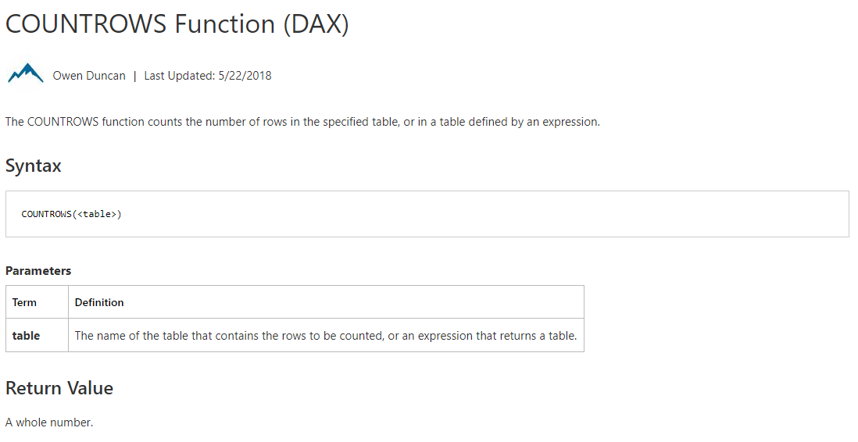
Module 05a – The Basics – Commons Measures

Slide 28
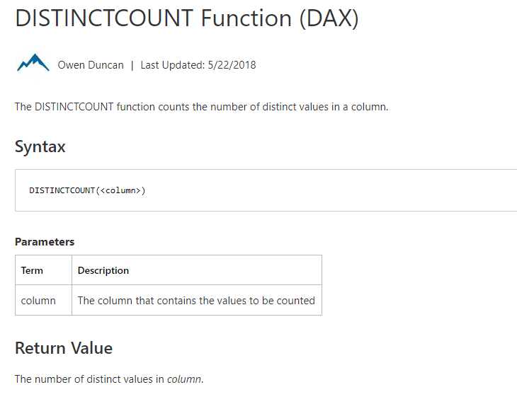
Module 05a – The Basics – Commons Measures

Slide 29
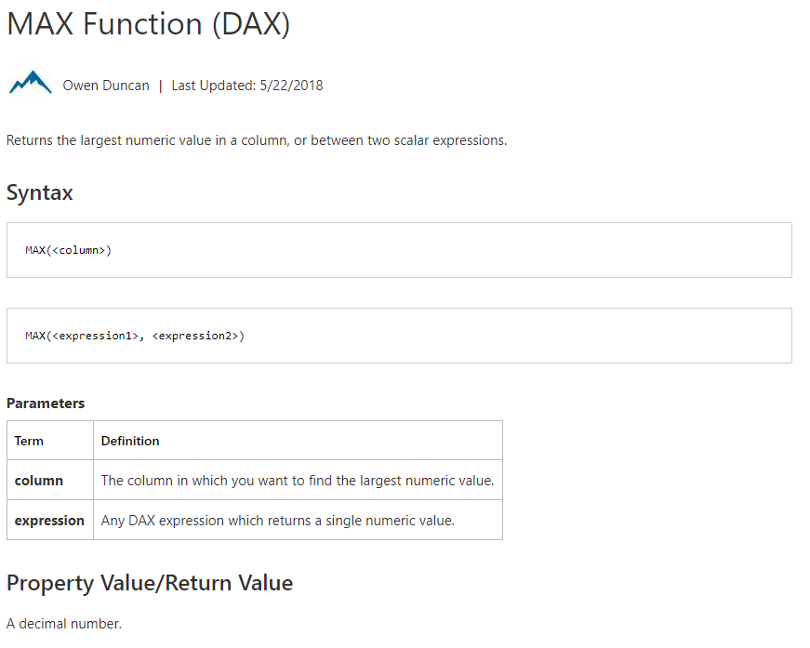
Module 05a – The Basics – Commons Measures

Slide 30
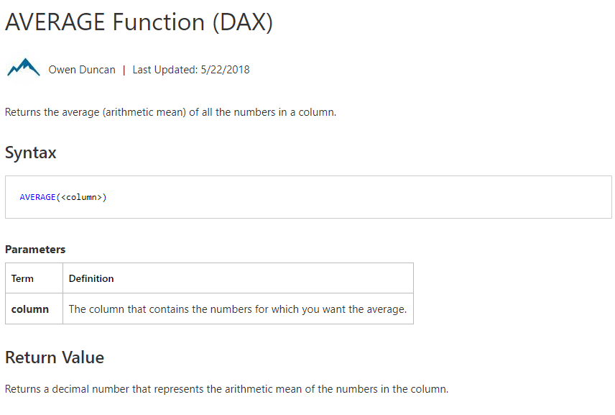
Module 05a – The Basics – Commons Measures

Slide 31
Module 05a – The Basics – Commons Columns
IF
Checks if a condition is met (just like Excel)
RELATED
Returns a related value from another table
LOOKUPVALUE
Retrieves a value from a table (not related)
Like VLOOKUP or INDEX MATCH
ISBLANK
Checks if a value is blank (TRUE or FALSE)

Slide 32
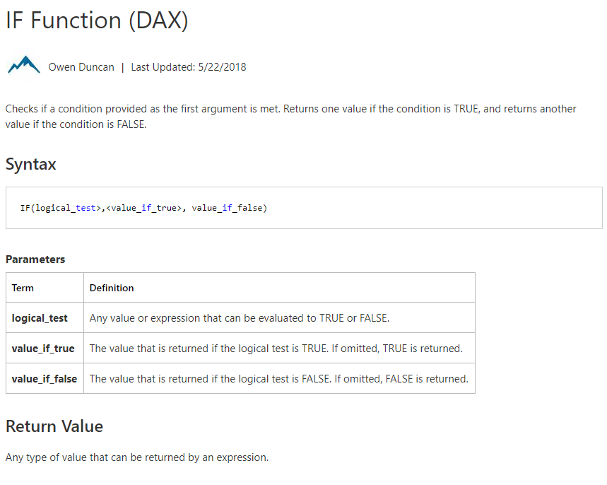
Module 05a – The Basics – Commons Columns

Slide 33
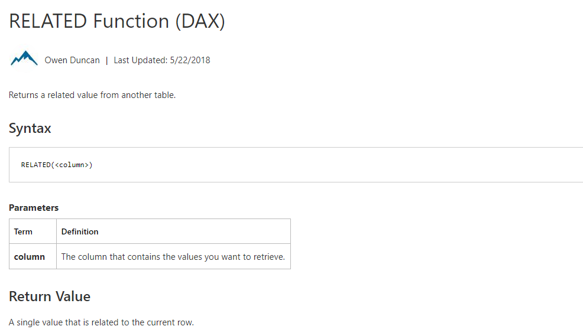
Module 05a – The Basics – Commons Columns

Slide 34
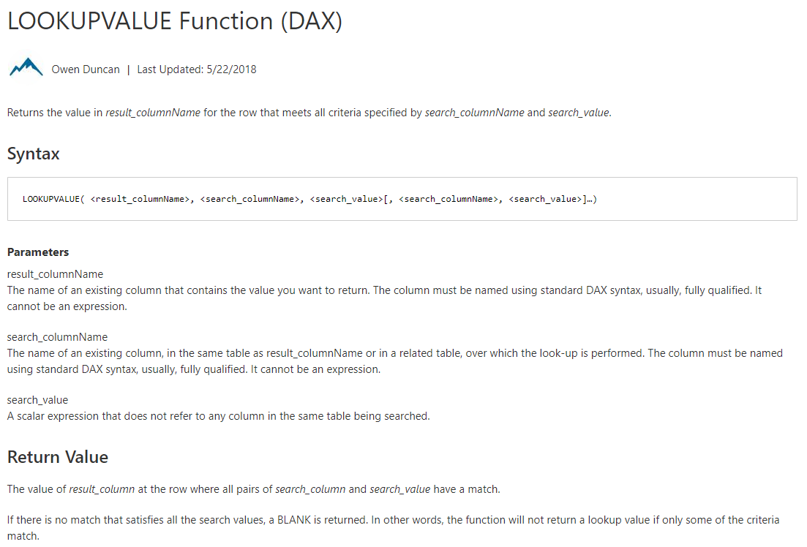
Module 05a – The Basics – Commons Columns

Slide 35
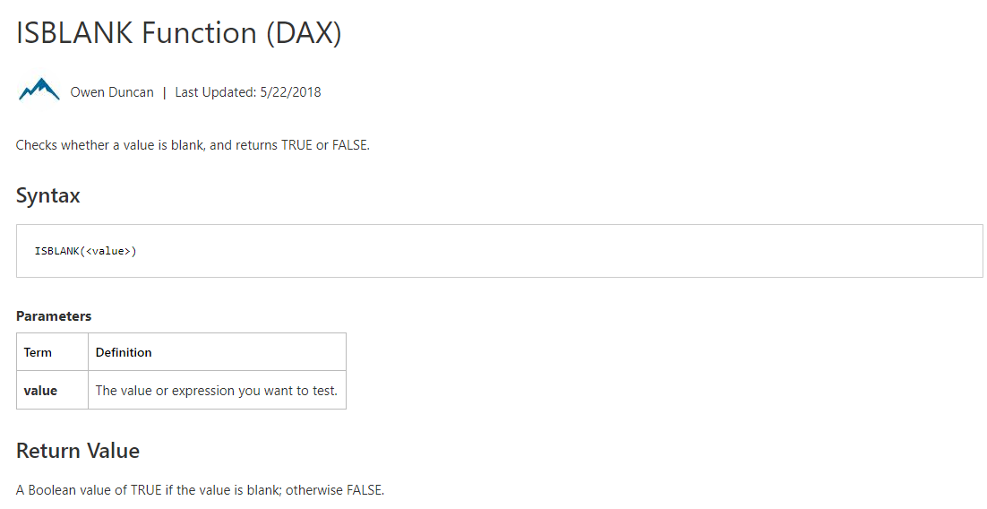
Module 05a – The Basics – Commons Columns

Slide 36
Module 05a: Demo

Slide 37
Module 05b: Commons Super Stars

Slide 38
Module 05b – The Super Stars
Once you have your “Commons” down, now you can build off of them with Filter / Info functions
Ability to manipulate context to create dynamic calculations
Time Intelligence using time periods to compare
Also known as the SUPER STARS
Notes:
Ok great, Commons are down. Now we can build off to create SUPER STARS.
These really give you the full power of DAX and in your reporting.

Slide 39
Module 05b – The Super Stars
Super Star Functions are usually nested or combined with other Functions
Cannot just use single function alone in a formula
Requires a common or basic function to support it
These transform or modify the context or expression of a common evaluation
Notes:
As we said, Super Star functions are usually combined with other functions.

Slide 40
Module 05b – The Super Stars
Super Star Functions – Measures
CALCULATE
FILTER
USERELATIONSHIP
ALL FUNCTIONS
IN
Super Star Functions – Tabular
DISTINCT
VALUES
UNION
SUMMARIZE
SWITCH

Slide 41
Module 05b – The Super Stars Measures
CALCULATE
Evaluates an expression modified by specific filters (Updates, Adds, etc.)
Use expressions that define a filter
FILTER
Returns a table that represents a subset of another table or expression
Commonly use the FILTER argument inside CACULATE
USERELATIONSHIP
Makes an inactive relationship active in the specific calculation
Used for tables with multiple date periods (Order Date, Shipped Date)
ALL FUNCTIONS
ALL, ALLEXCEPT, ALLSELECTED
Ignores any filters that have been applied
IN
Mirror of the SQL “IN"

Slide 42
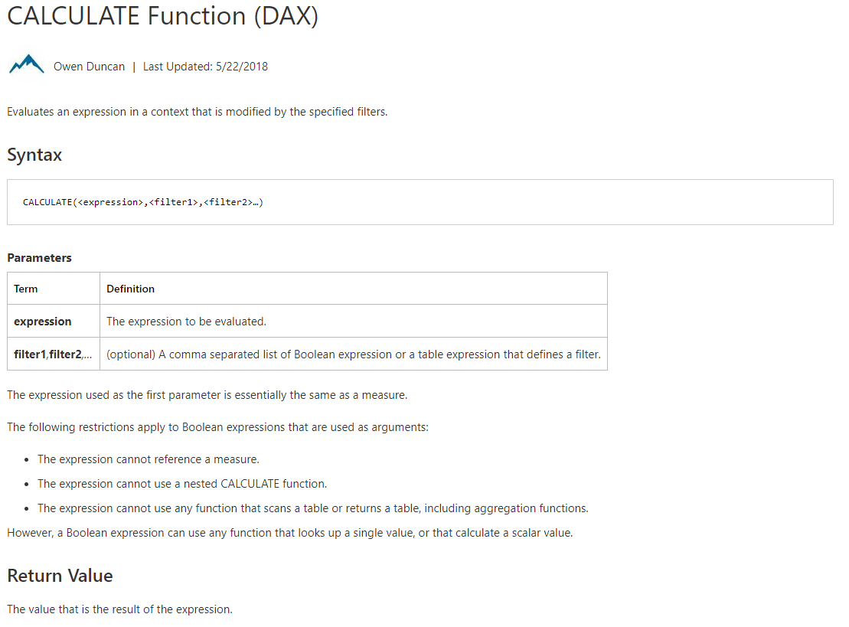
Module 05b – The Super Stars Measures

Slide 43
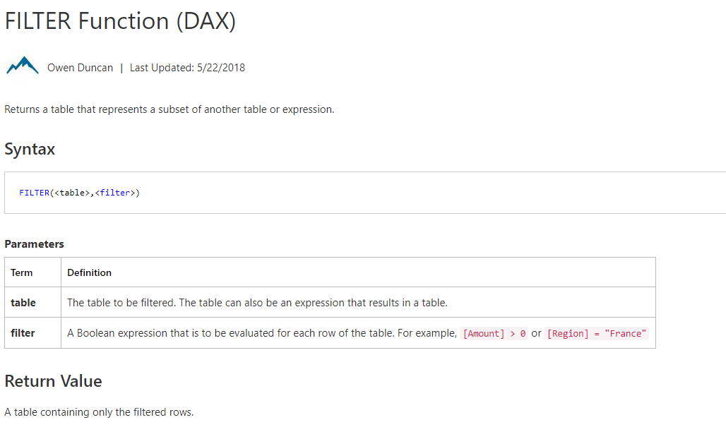
Module 05b – The Super Stars Measures

Slide 44
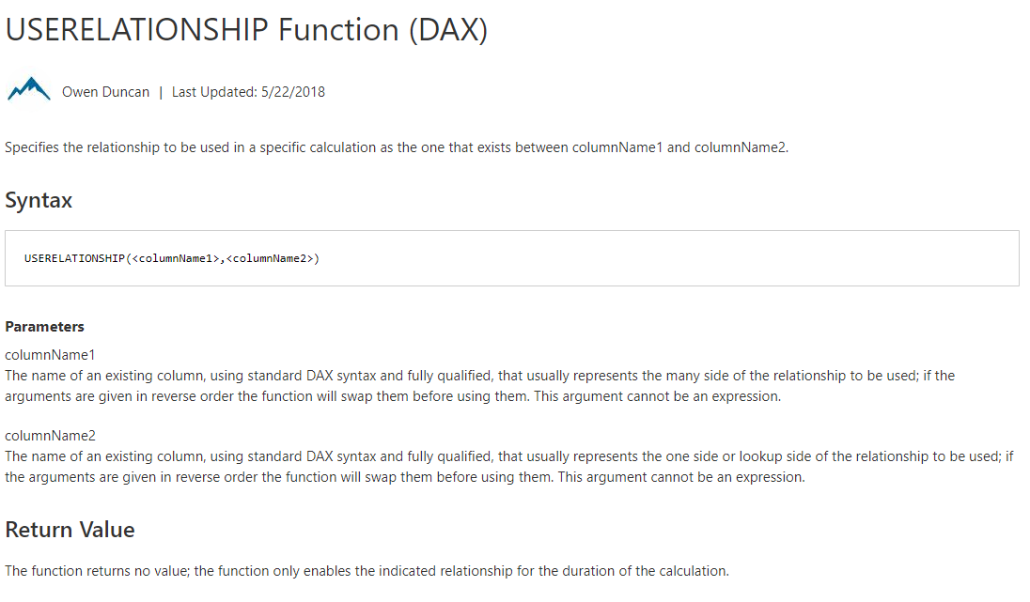
Module 05b – The Super Stars Measures

Slide 45
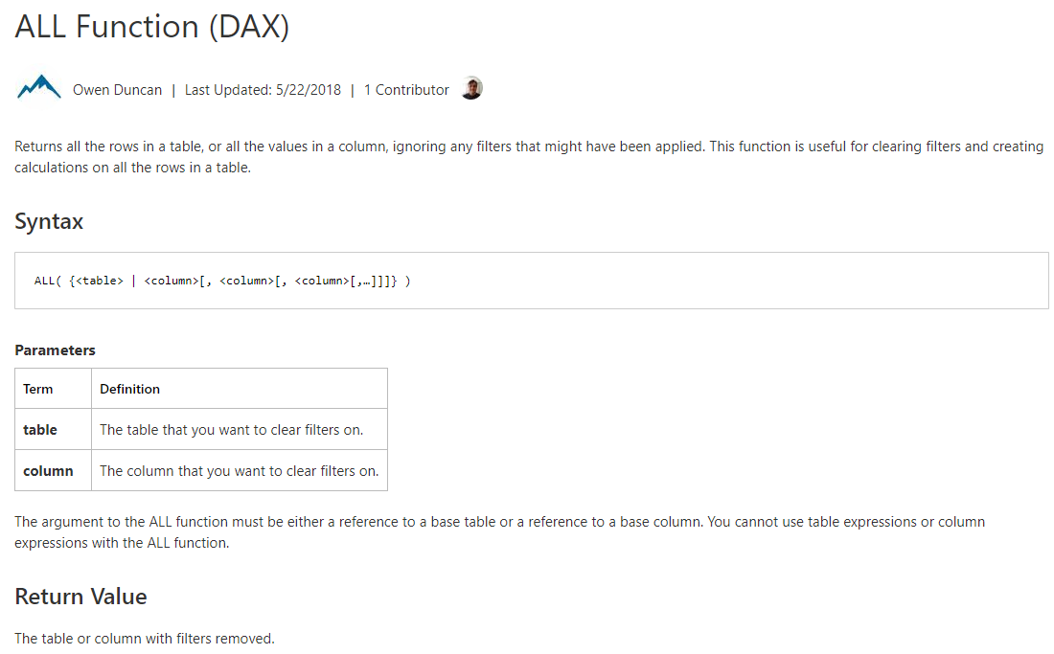
Module 05b – The Super Stars Measures

Slide 46
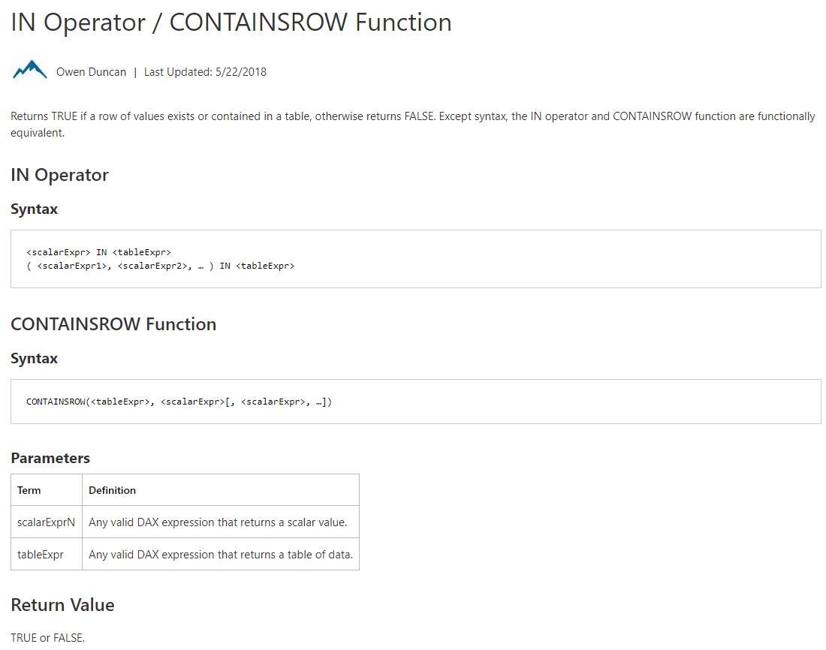
Module 05b – The Super Stars Measures

Slide 47
Module 05b – The Super Stars Tabular
DISTINCT & VALUES
Both return a column of unique values (one column returned)
Similar for each, but VALUES will return blank values as well
UNION
Creates a unique joined table from a pair of tables
Uses – to create a bridge to relate tables together
SUMMARIZE
Returns a table that is grouped by columns
Can create columns based on Groups
SWITCH
Evaluates expression against of values and returns result if true
Like nested IF statements

Slide 48
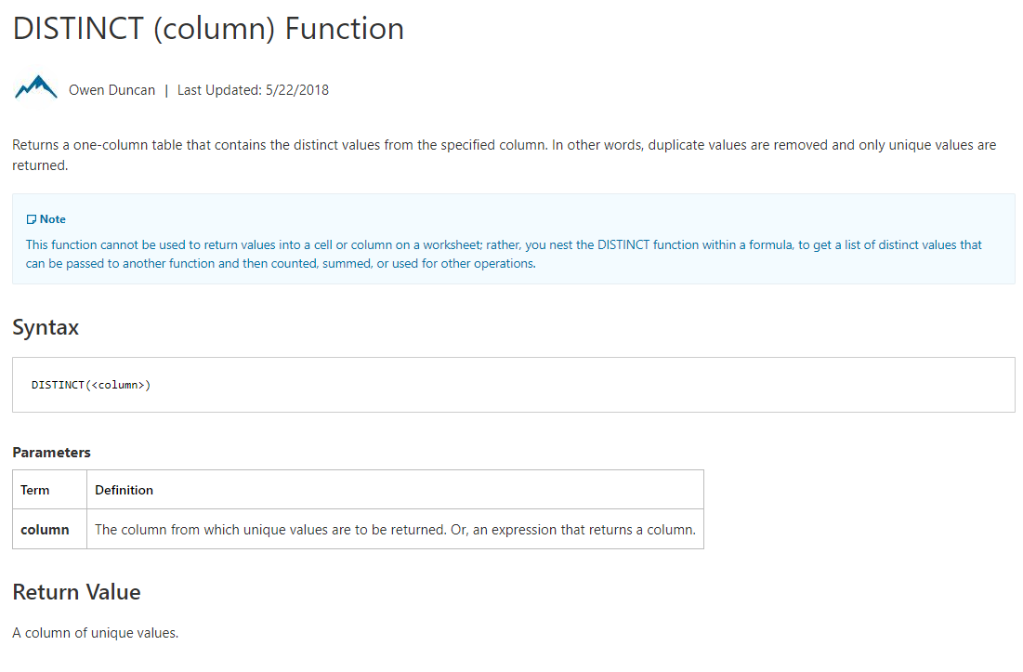
Module 05b – The Super Stars Tabular

Slide 49
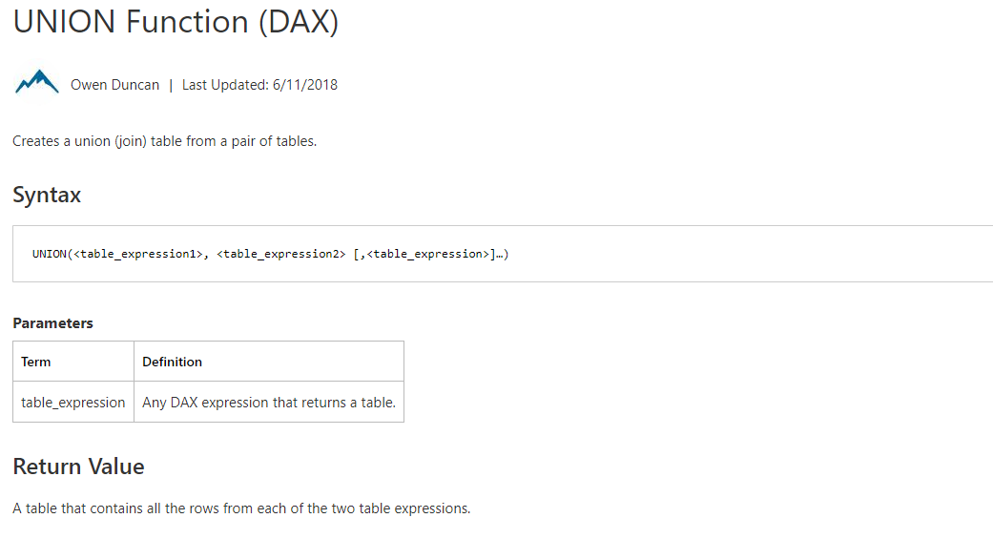
Module 05b – The Super Stars Tabular

Slide 50
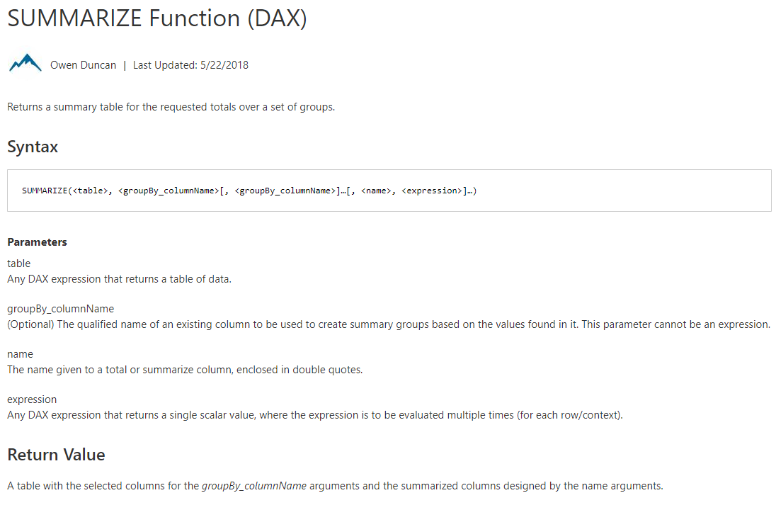
Module 05b – The Super Stars Tabular

Slide 51
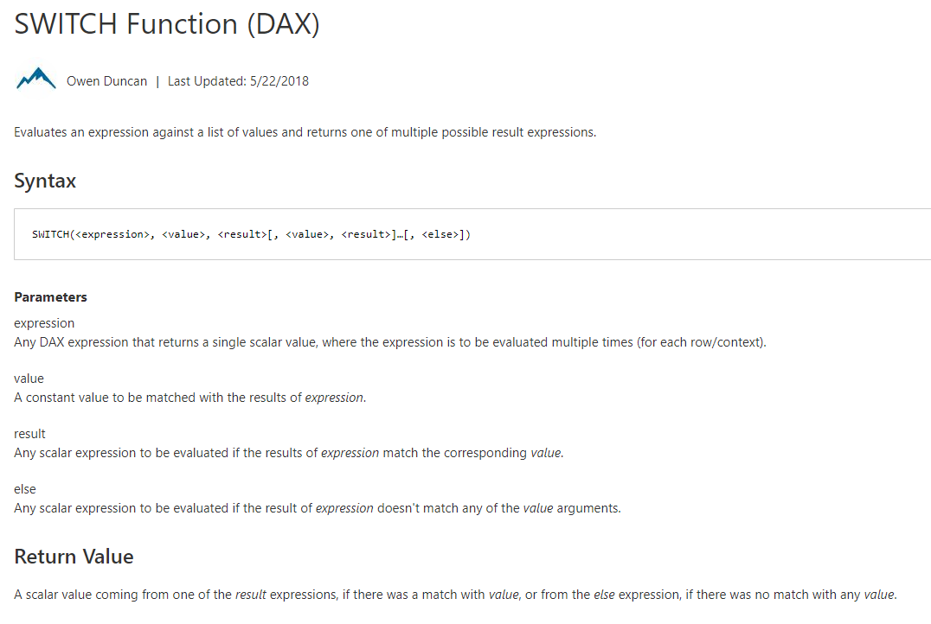
Module 05b – The Super Stars Tabular

Slide 52
Module 05b: Demo

Slide 53
Module 05c: Date & Time Intelligence

Slide 54
Module 05c – Date & Time Intelligence
One of the most powerful features of DAX
Modify time periods, compare previous or parallel time frames
Useful and built-in Intelligence for Month, Quarter, Years

Slide 55
Module 05c – Date & Time Intelligence
Time Intelligence – Measures
DATES (MTD, QTD, YTD)
LASTNONBLANK | FIRSTNONBLANK
DATESBETWEEN | DATESINPERRIOD
DATEADD
SAMEPERIODLASTYEAR
ENDOF (MONTH | QUARTER | YEAR)
PARALLELPERIOD
STARTOF (MONTH | QUARTER | YEAR)
Date and Time – Measures
TODAY
DATE
CALENDAR
DATEDIFF
YEAR
WEEKDAY

Slide 56
Module 05c – Date and Time Measures
TODAY
Returns the current date
DATE
Returns the specified date
CALENDAR
Returns a table with one column of dates between specific dates
DATEDIFF
Returns the number of units between two input dates
DAY | MONTH | YEAR
Returns a number representing the particular value

Slide 57
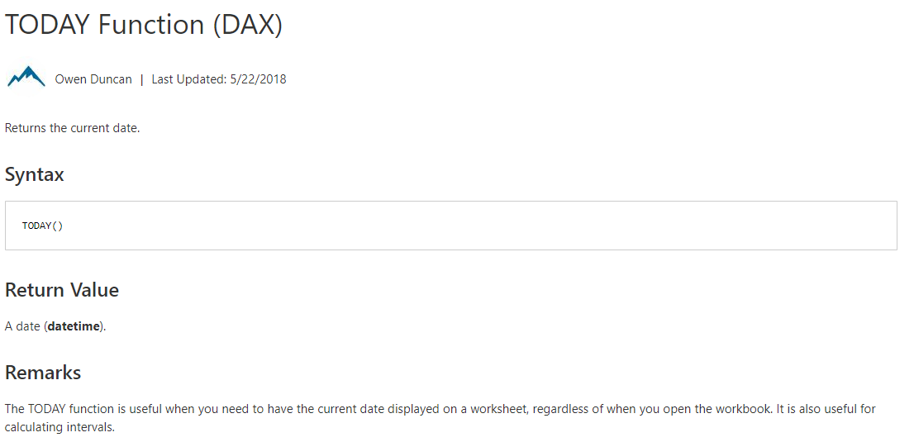
Module 05c – Date and Time Measures

Slide 58
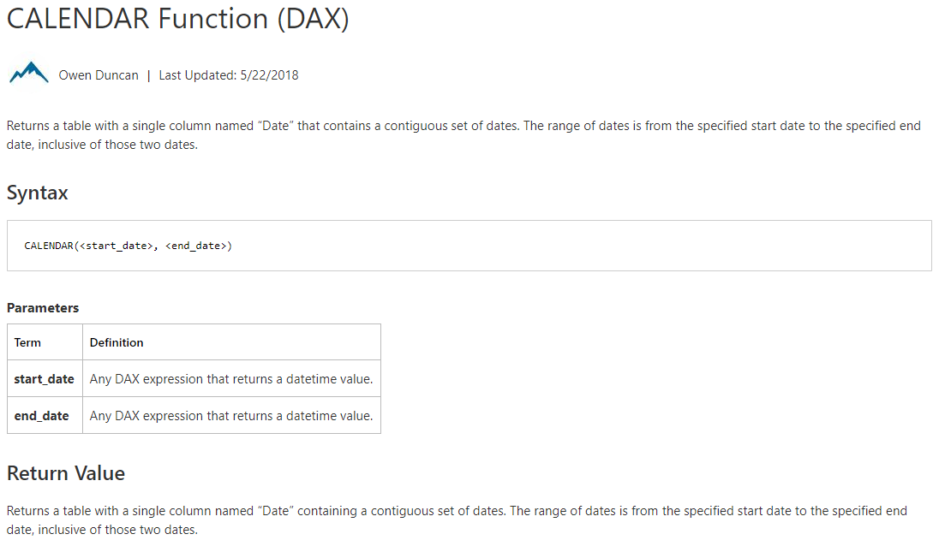
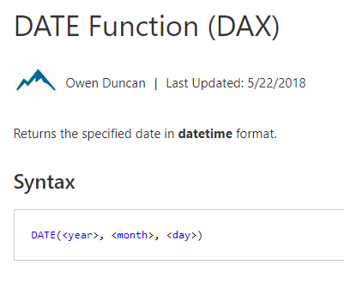
Module 05c – Date and Time Measures

Slide 59
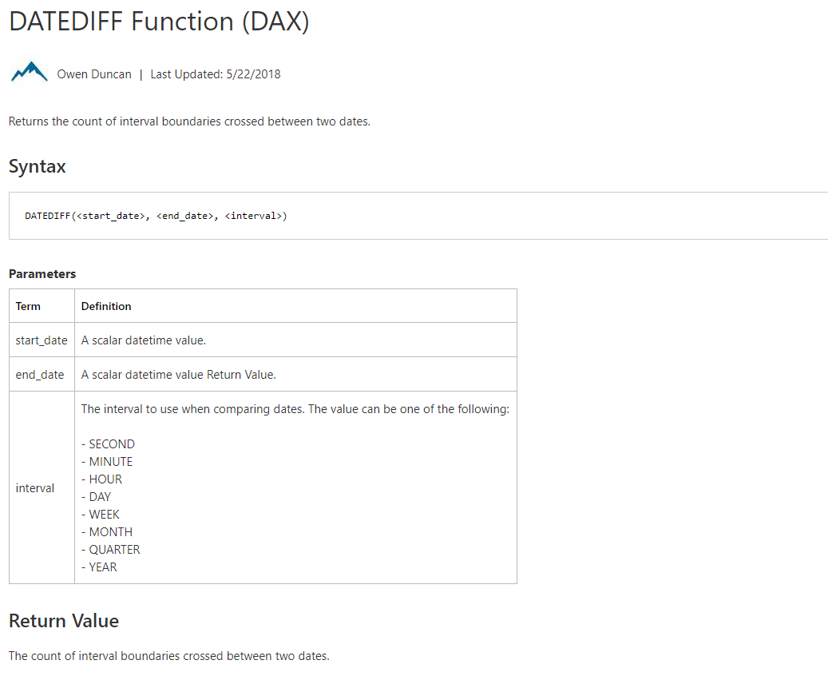
Module 05c – Date and Time Measures

Slide 60
Module 05c – Time Intelligence Measures
DATESMTD | DATESQTD | DATESYTD
Returns a set of dates in the period up to the current date
LASTNONBLANK | FIRSTNONBLANK
Returns first | last value in a column
DATESBETWEEN | DATESINPERIOD
Returns the dates between two given dates or in a given period
DATEADD
Moves the given set of dates by a specified interval
SAMEPERIODLASTYEAR | PARALLELPERIOD
Returns a set of dates from the previous year or parallel period
STARTOF | ENDOF (MONTH | QUARTER | YEAR)
Returns either the start of end of the specified period as date

Slide 61
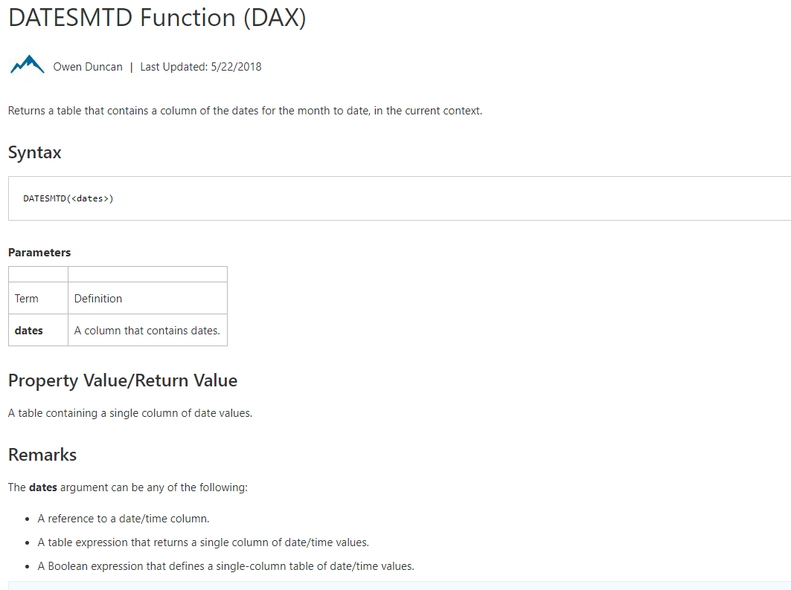
Module 05c – Time Intelligence Measures
Notes:
Same for QtD, YtD

Slide 62
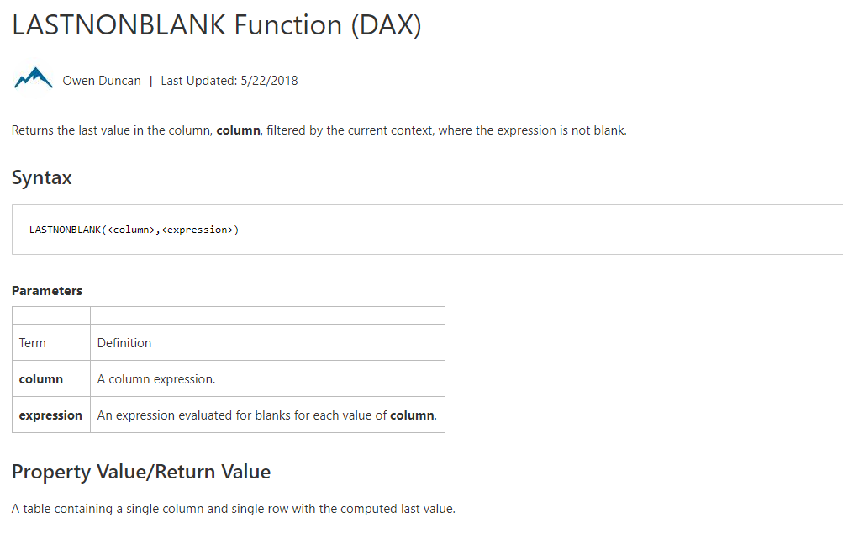
Module 05c – Time Intelligence Measures

Slide 63
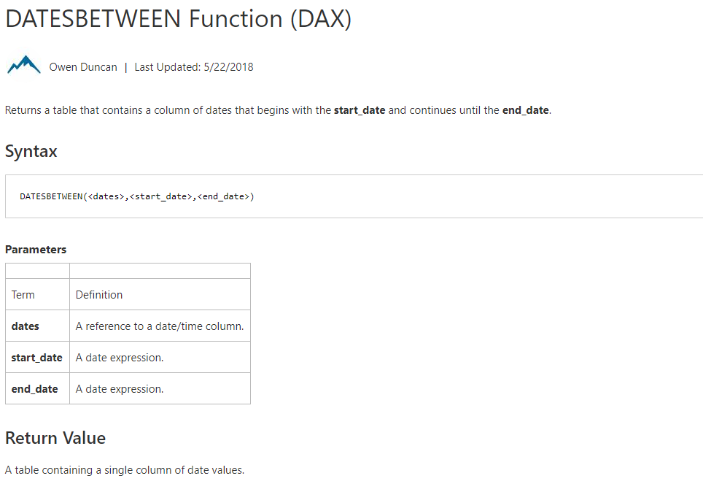
Module 05c – Time Intelligence Measures

Slide 64
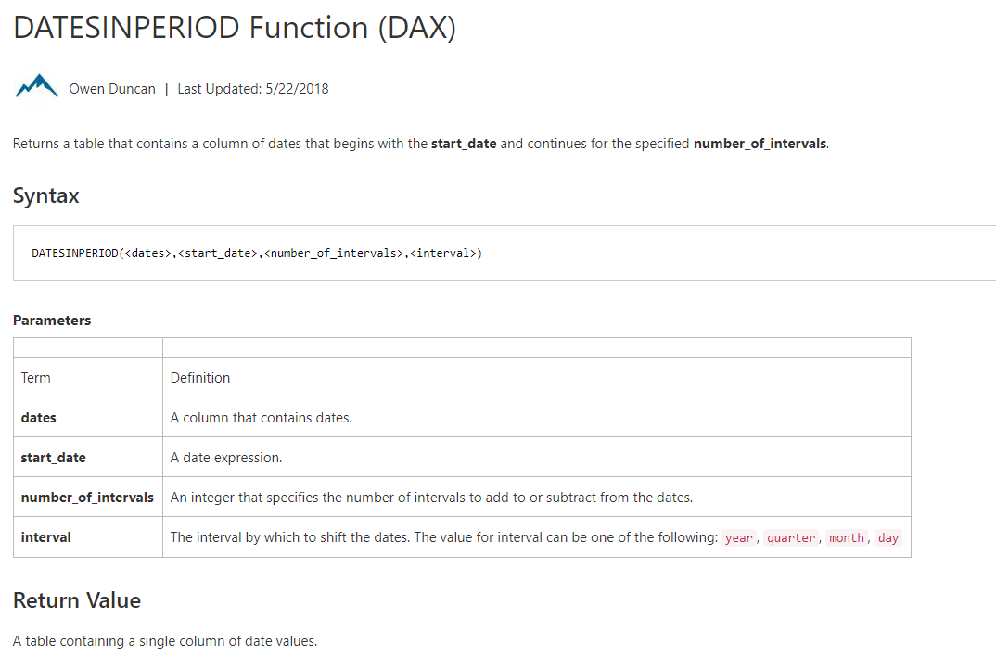
Module 05c – Time Intelligence Measures

Slide 65
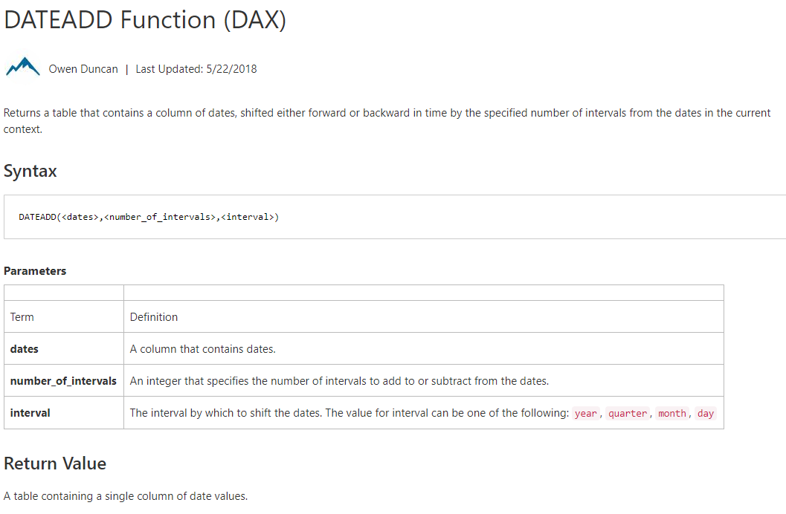
Module 05c – Time Intelligence Measures

Slide 66
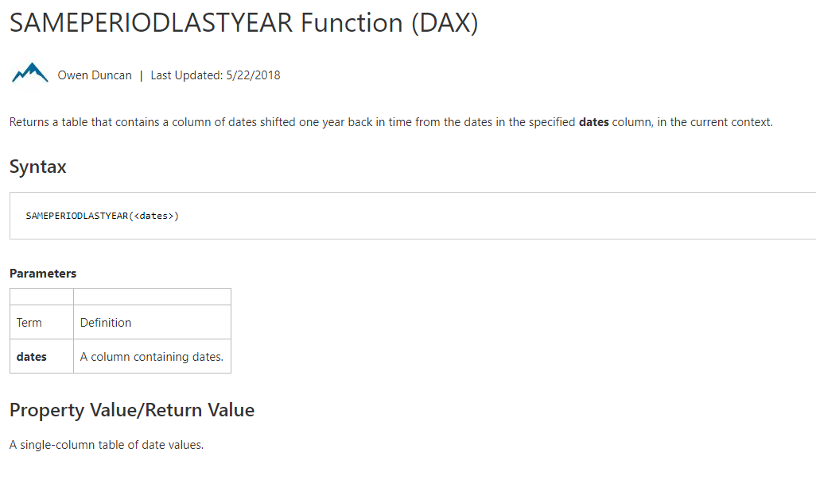
Module 05c – Time Intelligence Measures

Slide 67
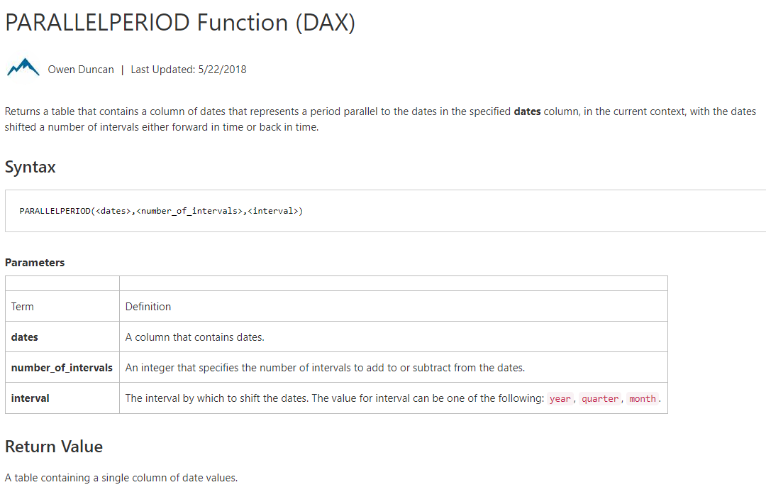
Module 05c – Time Intelligence Measures

Slide 68
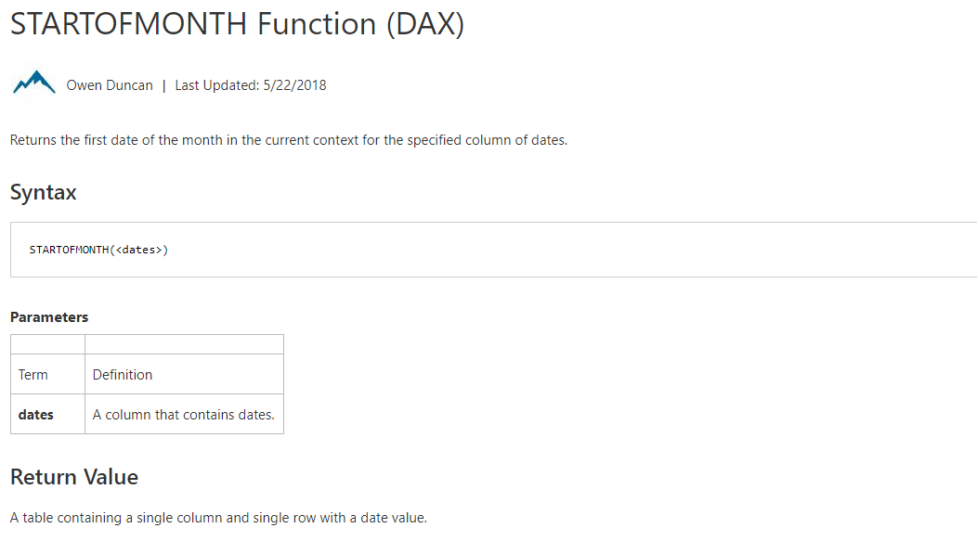
Module 05c – Time Intelligence Measures

Slide 69
Module 05c – Examples
Year to Date
Period over Period (Total)
Period over Period (by current time frame)
Notes:
Total Sales Last Month =
CALCULATE([Total Sales],
PREVIOUSMONTH(DateDim[Date]))
MoM =
DIVIDE([Total Sales] - [Total Sales Last Month],
[Total Sales Last Month])

Slide 70
Module 05c: Demo
Notes:
Year to Date
Period over Period (Total)
Period over Period (by current time frame)
Rolling Time frame

